Slide 1
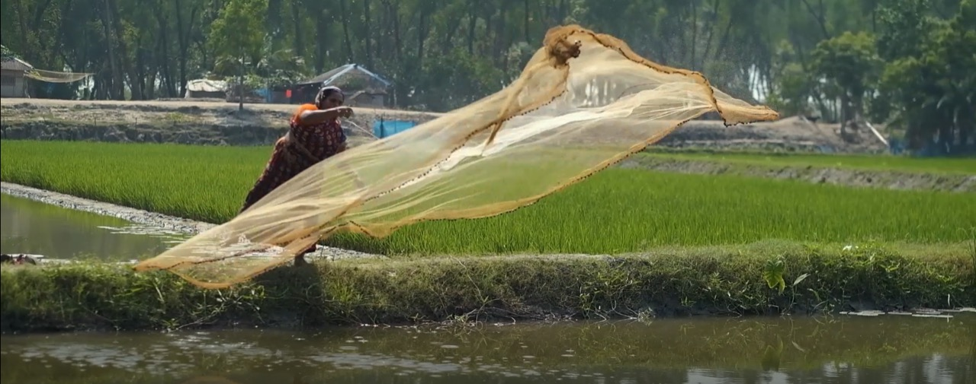
Social resilience in the Sundarbans Delta:
Knowledge coproduction and implementation through inland fishing

Slide 2
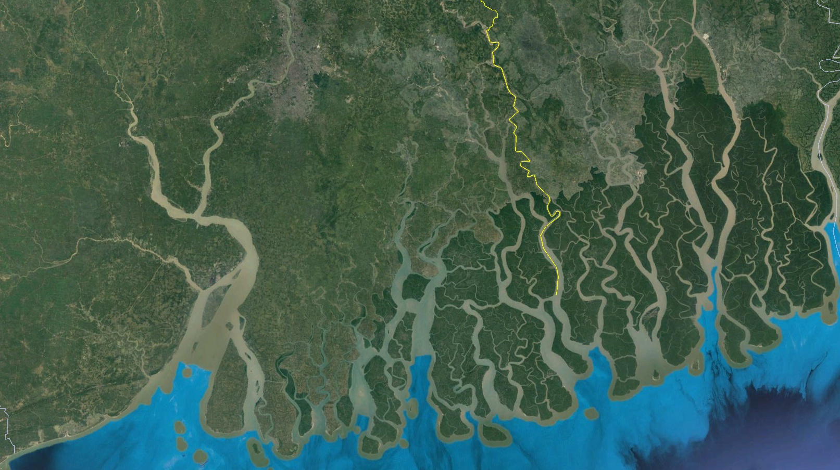





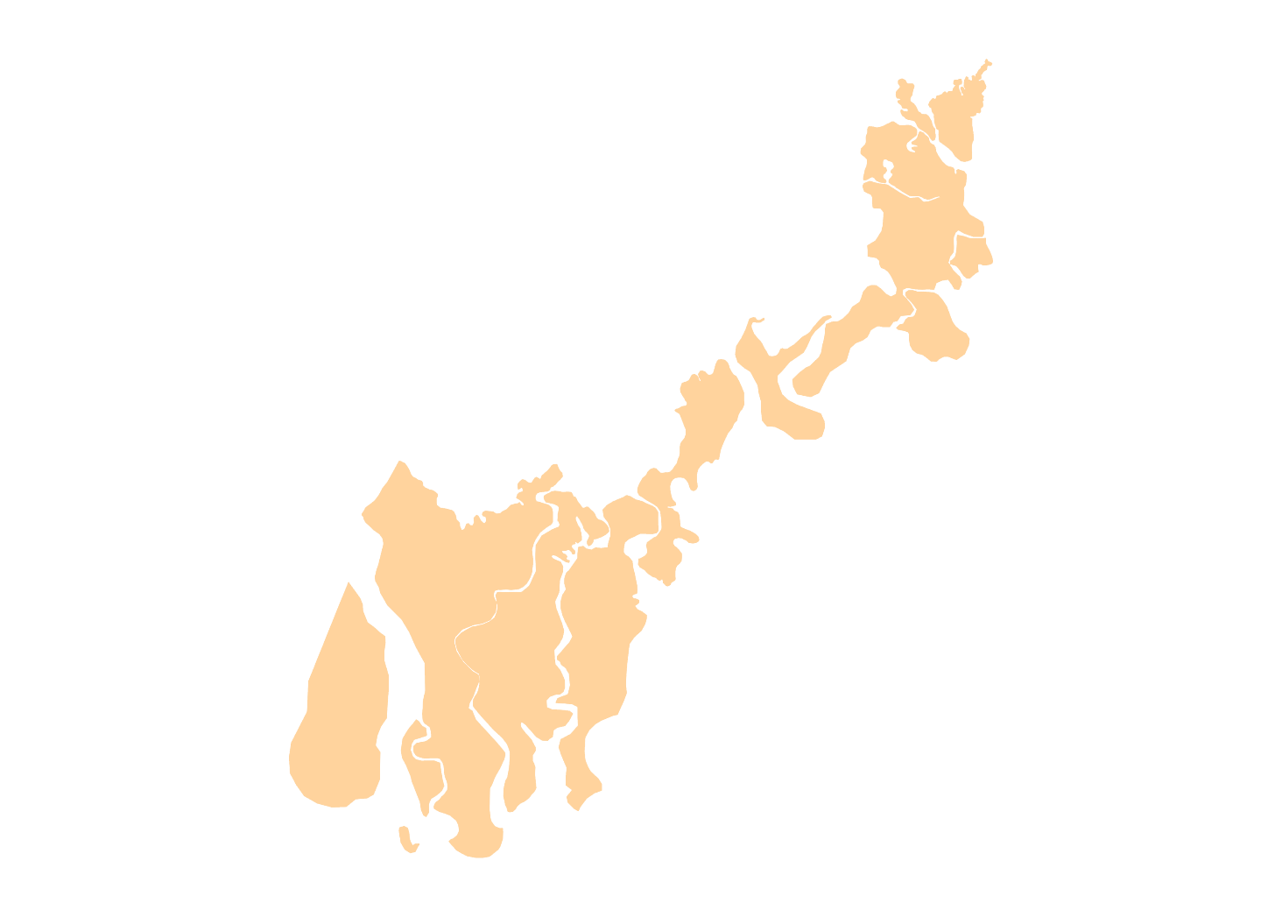
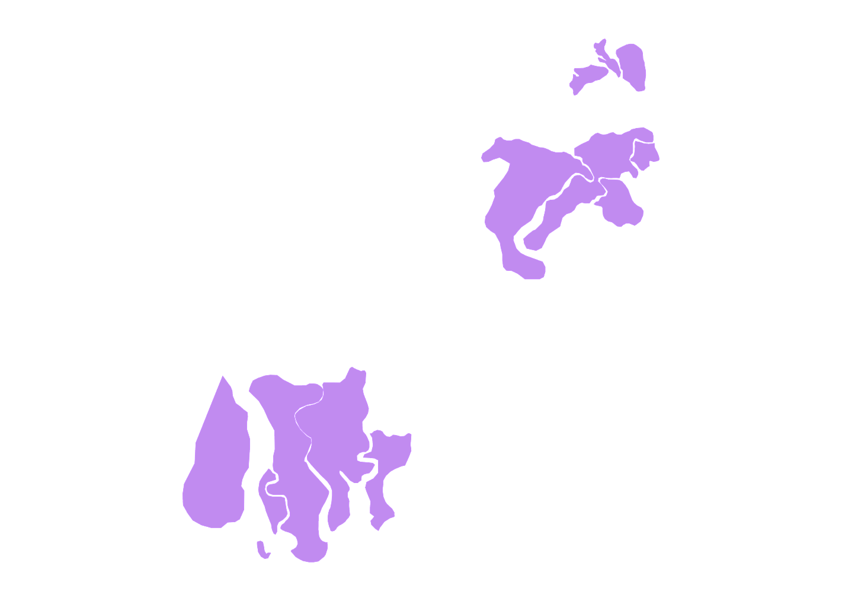
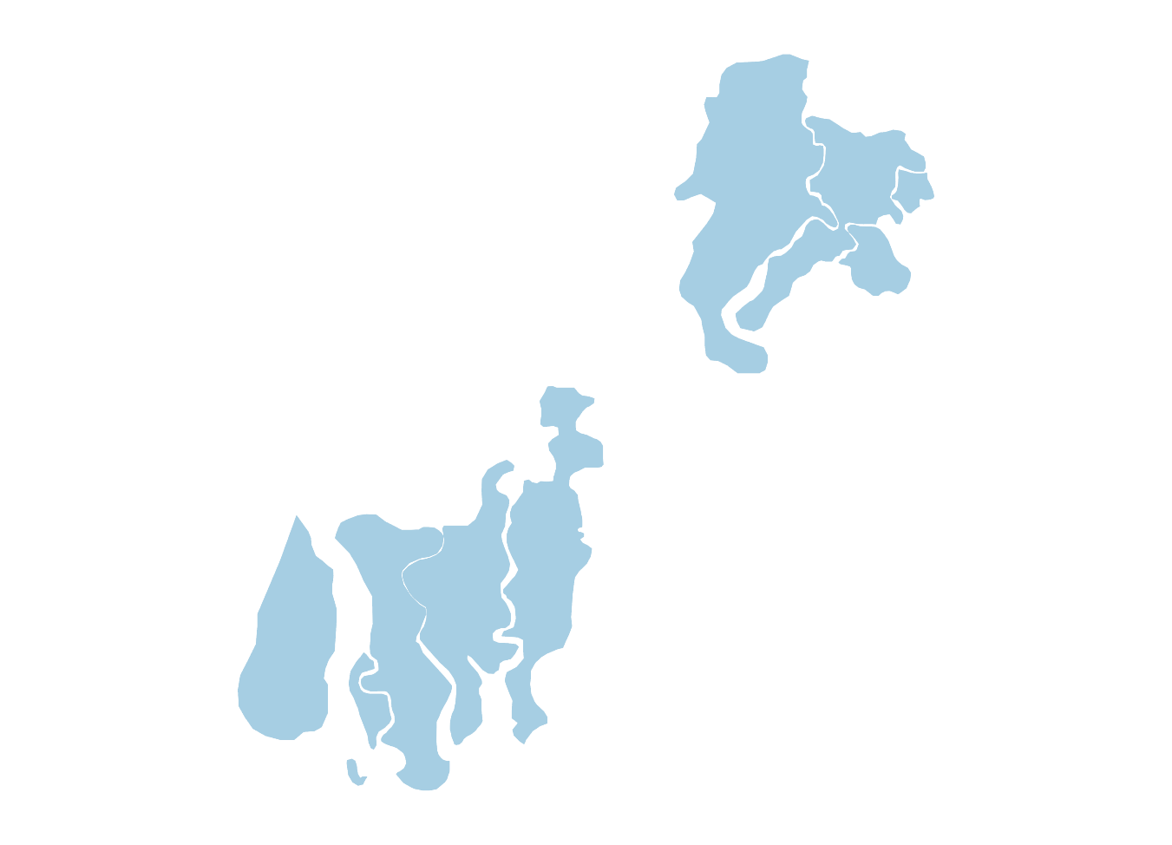
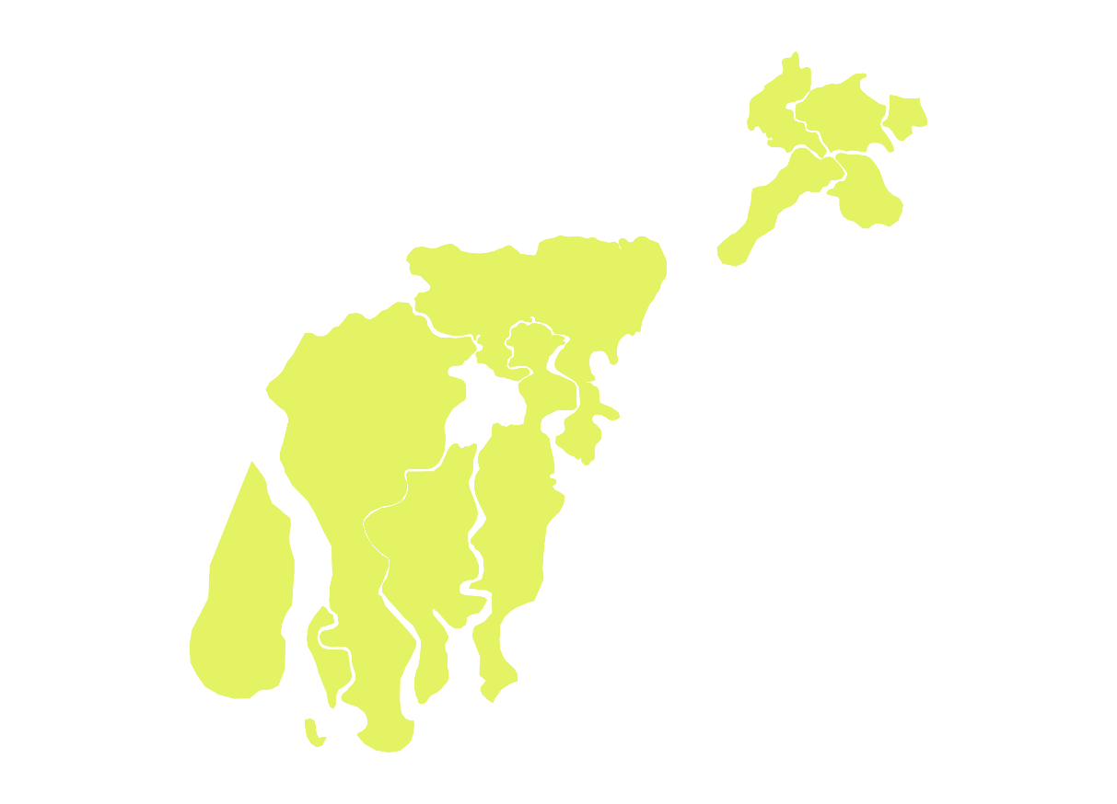
The Sundarbans Delta
AILA (2009)
N
BULBUL (2019)
AMPHAN (2020)
YAAS (2021)
Assasuni
Kumirmari
Sundarbans Biosphere Reserve
(India)
Sundarbans Reserve Forest
(Bangladesh)
Bay of Bengal
Notes:
The Sundarbans is the world’s largest mangrove delta. It is a climate change hotspot, the intensity of cyclones exacerbating in the last two decades.
For example: show the map and explain with clicks – AILA (2009), Bulbul (2019), Amphan (2020), Yaas (2021)
Climatological simulations predict that the frequency of extreme events like super cyclones and tidal surges will continue to increase in the Bay of Bengal.
7.7 million people live there, 2.7 million in Bangladesh and 5 million in India. As the number of cyclonic storms increases, tidal surges will flood homes, make fields salty, and wash away villages.

Slide 3
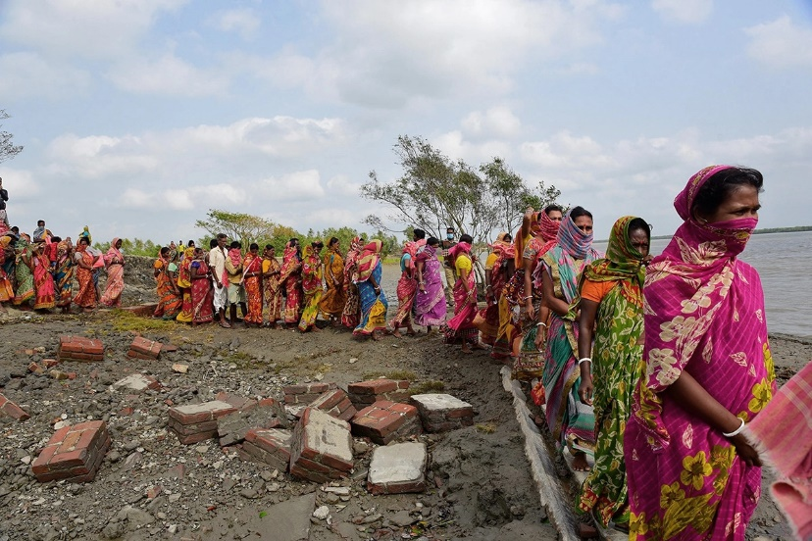
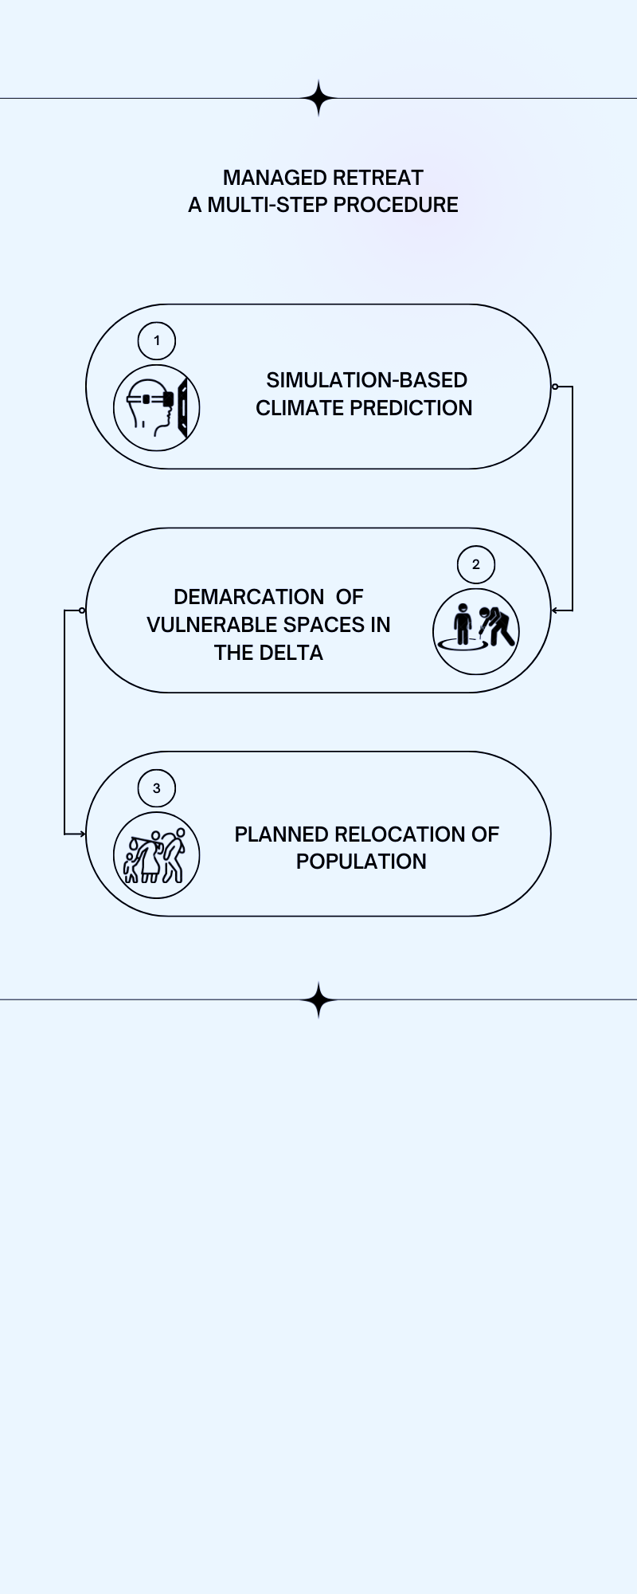
Managed retreat?
Notes:
In response researchers and policymakers have called upon the governments of India and Bangladesh to begin strategic planning for a “managed retreat” for the Sundarbans. The WWF-led Delta Vision Plan 2050 is a progenitor of managed retreat in the Sundarbans.
Managed (sometimes called planned) retreat is a complex multi-step procedure, which begins by modelling multi-hazard systems which would simulate the effects of cyclone, riverine and oceanic floods together to see how parts of the delta would be submerged. This is followed by demarcating vulnerable spaces in the delta and the phased process of planned relocation of populations from those areas.
This would involve moving 1 million people out of the delta.
But is retreating to a higher ground a desired future even in our climate changed world? Does it include the concerns of the islanders: where they will move to, what they will do there, whether they want to move?

Slide 4
Social resilience
“Cyclones hit us hard and snatch away everything from us. And then, the increasing threats of tiger attacks in forest fishing on one hand and the brutal forest officers on the other! Yet, we prefer staying here. This is our land, our habitat, and we know the rhythms of the delta. Many of us have shifted to inland fishing in our household premises. We are constantly trying to cope against the ‘risk basket’ thrust upon us.”
– an elderly villager from Kumirmari, Gosaba
disaster risk reduction (DRR)
single disaster approach
predict and provide
social resilience
multiple disruptive risks
respond and recover
Notes:
Our more than one decade of historical and ethnographic research in the Sundarbans probing into everyday lived realities attest that the future the community (fishers, farmers, honey gatherers, boatmen) imagine for the Sundarbans calls for a different dialogue about climate adaptation.
And it is here that we pitch ‘social resilience’ as an enabler, unleashing options and possibilities of ‘staying’ in the delta and argue how this is a more desirable and viable climate adaptation strategy for, of and by the community.
We are influenced by Pemberton et al. 2021 paradigm of ‘staying’ as climate change adaptation strategy.
The communities are improvising on and innovating methods using inter-generational skills, expertise and knowledge responding to socio-ecological vulnerabilities. Most interestingly, their place-based, creative solutions accommodate multi-faceted vulnerabilities or ‘multiple disruptive risks’ that dot the delta and turn it into a ‘riskscape’.
Unlike managed retreat, social resilience is sensitive to diverse realities, desires and especially multi-faceted vulnerabilities of the people impacted upon by climate change policies.
More comprehensive understandings of risks and response mechanisms that are historically contingent and place-based will do justice to the need for observing and learning from the delta rather than intervening with ideas of displacement and replacement.

Slide 5
mainstream understandings
simulation-based predictions and modelling
climate risks
climate policies and actions
plural epistemologies (experiential, textual, observation-induced)
standard/universal sets/principles of
engineering solutions and interventions
managed retreat
plural understandings and perceptions of multiple actors
multiple disruptive risks/riskscapes
place-based
inclusive
needs-driven
bottom-up interventions
(through knowledge coproduction and actions)
mainstream risk approach
social resilience approach
Notes:
More comprehensive understandings of risks and response mechanisms that are historically contingent and place-based will do justice to the need for observing and learning from the delta rather than intervening with ideas of displacement and replacement.

Slide 6
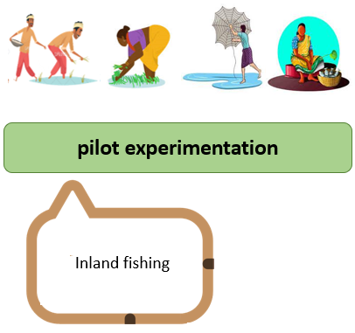
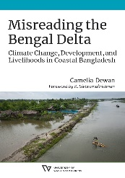
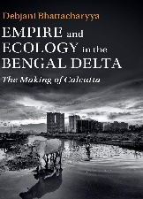



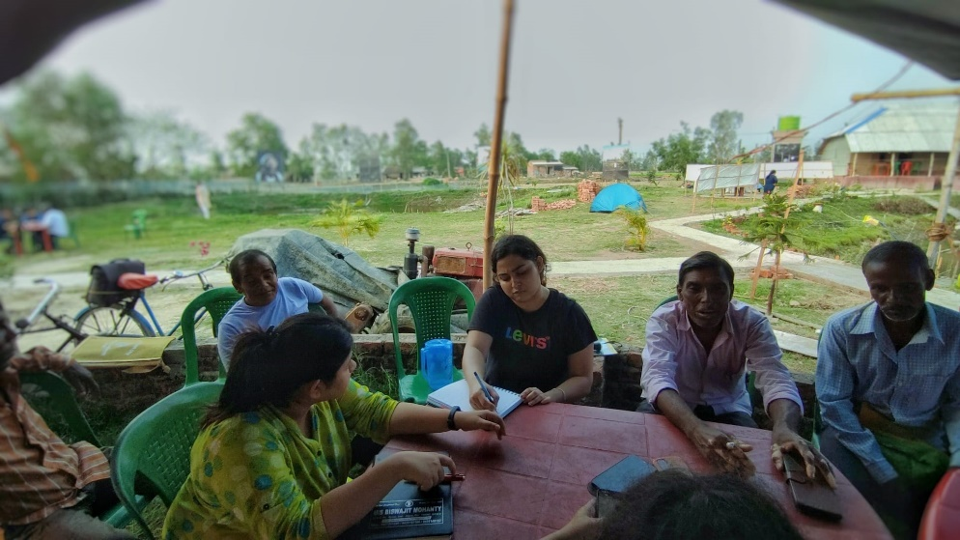
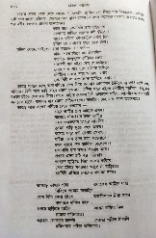
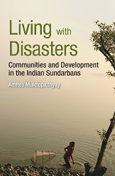


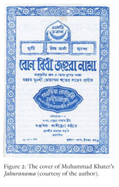
Methodology and Approach
historical ethnographic explorations
The A2E Approach
(Archival-Ethnographic-Experimentation)
Notes:
Here, we will explain the two-step methodology along the application of multi-modal qualitative research methods and pilot experimentations and actions to unravel risks and resilience in the delta, opening up pluriversal possibilities.
Understanding transboundary Sundarbans as ‘riskscapes’
[by exploring and mapping climate risks and disaster impacts on the Sundarbans, accommodating plural accounts of the state, NGOs and the island communities]
Mapping situated adaptive practices (SAPs)
[by documenting everyday existential realities and responses]
Identifying avenues to up-scale social resilience
[through transdisciplinary knowledge coproduction and implementation strategies, across cross-scalar bilateral exchanges along transboundary Sundarbans]

Slide 7




From thinking to ‘becoming with’
Knowing about
Thinking with
Becoming with
Epistemic encounters
Multi-modal methods
Understanding through the islands’/islanders’ perspectives
Self/others binary dismantled
Empathetic engagement
Ground(ed) knowledge
The epistempathetic departure

Slide 8


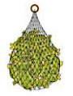
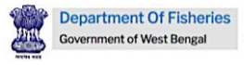
CLOC K2A SSG (2021-22)
Sundarban Jana Sramajibi Manch
Kumirmari, Gosaba
Training module on inland fishing in Coastal Sundarbans

Slide 9



Knowledge 2 Action
Training module on inland fishing
To products/outputs
Through (a desirable, evolutionary) process

Slide 10
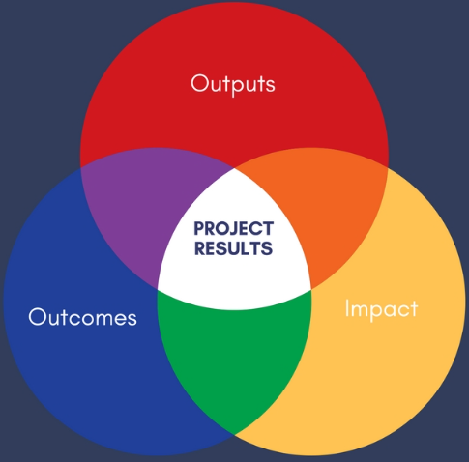
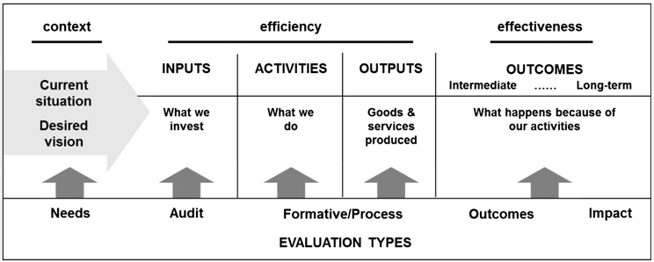
‘High impact pathways’
“Practice-oriented” training manual

Slide 11
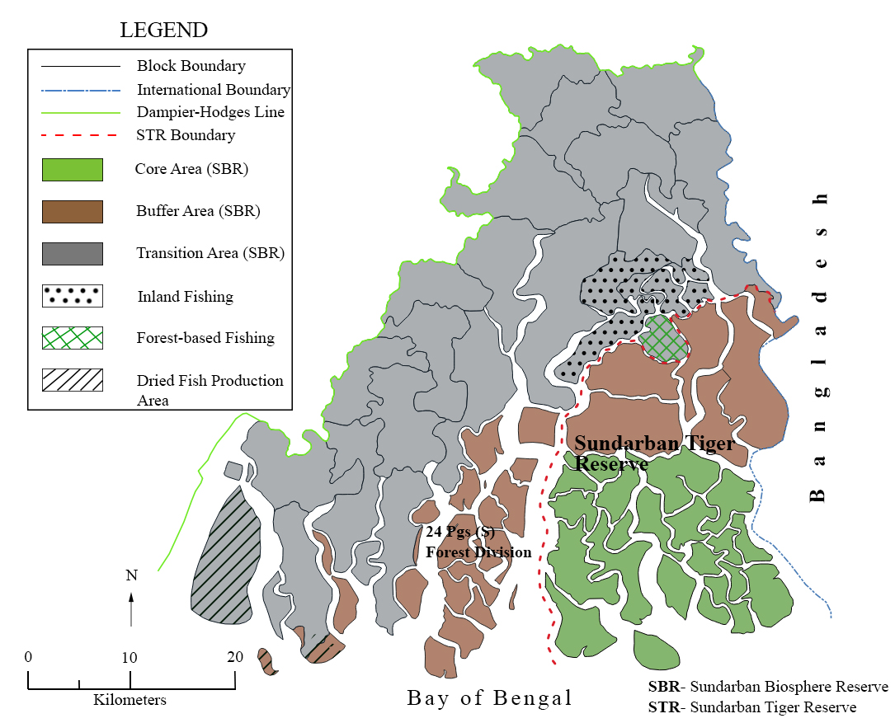
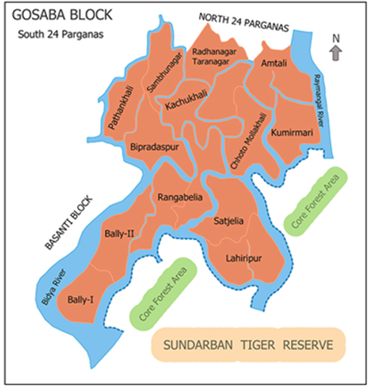
January 2021
Meandering through the muddyscape…

Slide 12
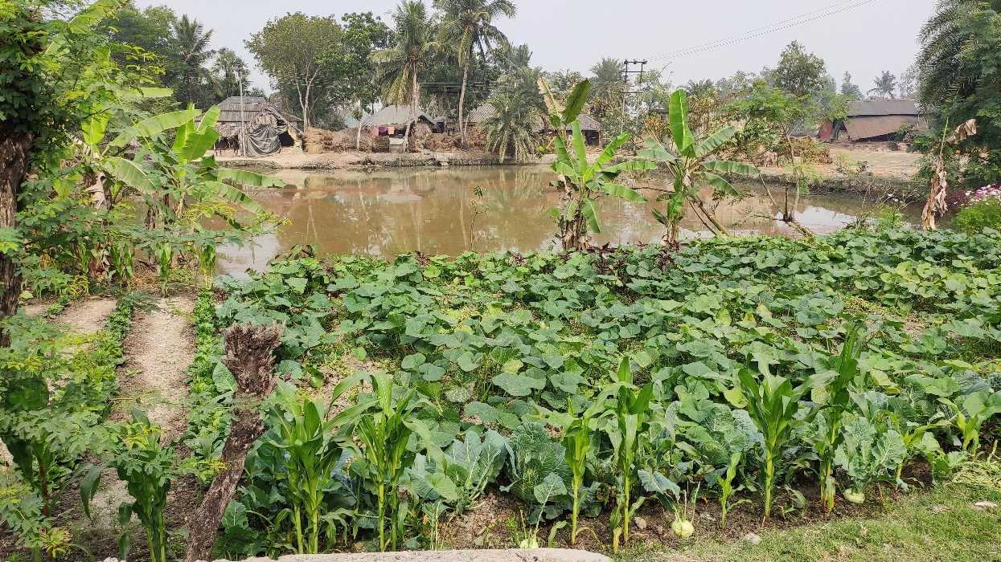
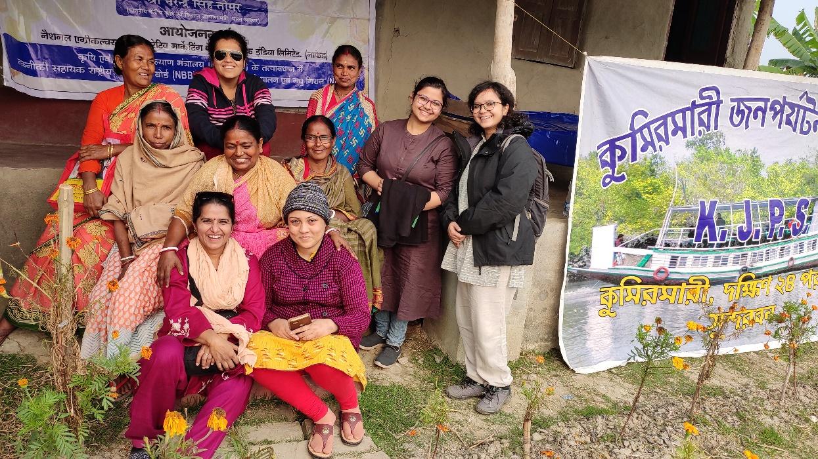
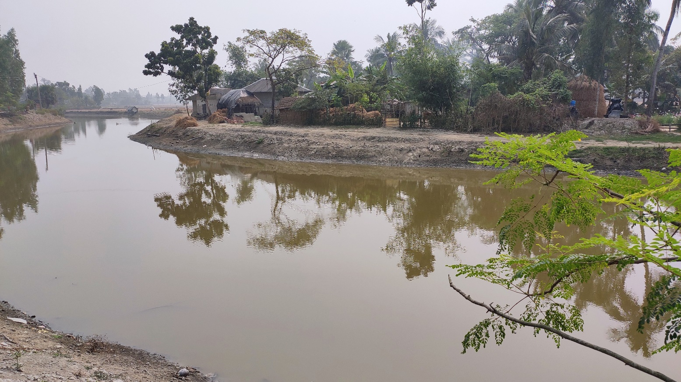
Why Kumirmari?
This island seemed different from the others.
Not passive spectators but coping actors in the ‘riskscapes’
Keen to know, share, learn and experiment
4,344 households (Census 2011), 3,000 ponds, 26 locally excavated khals (canals)

Slide 13
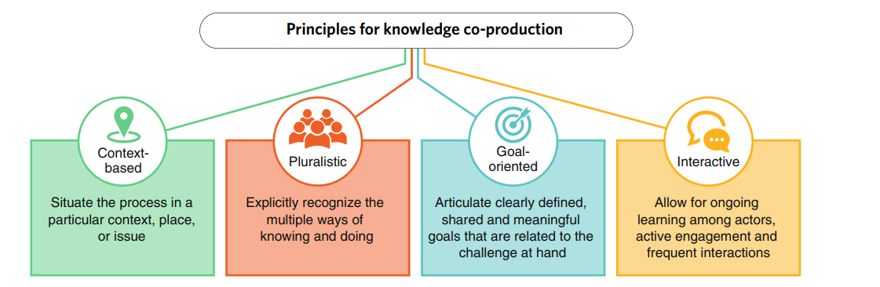
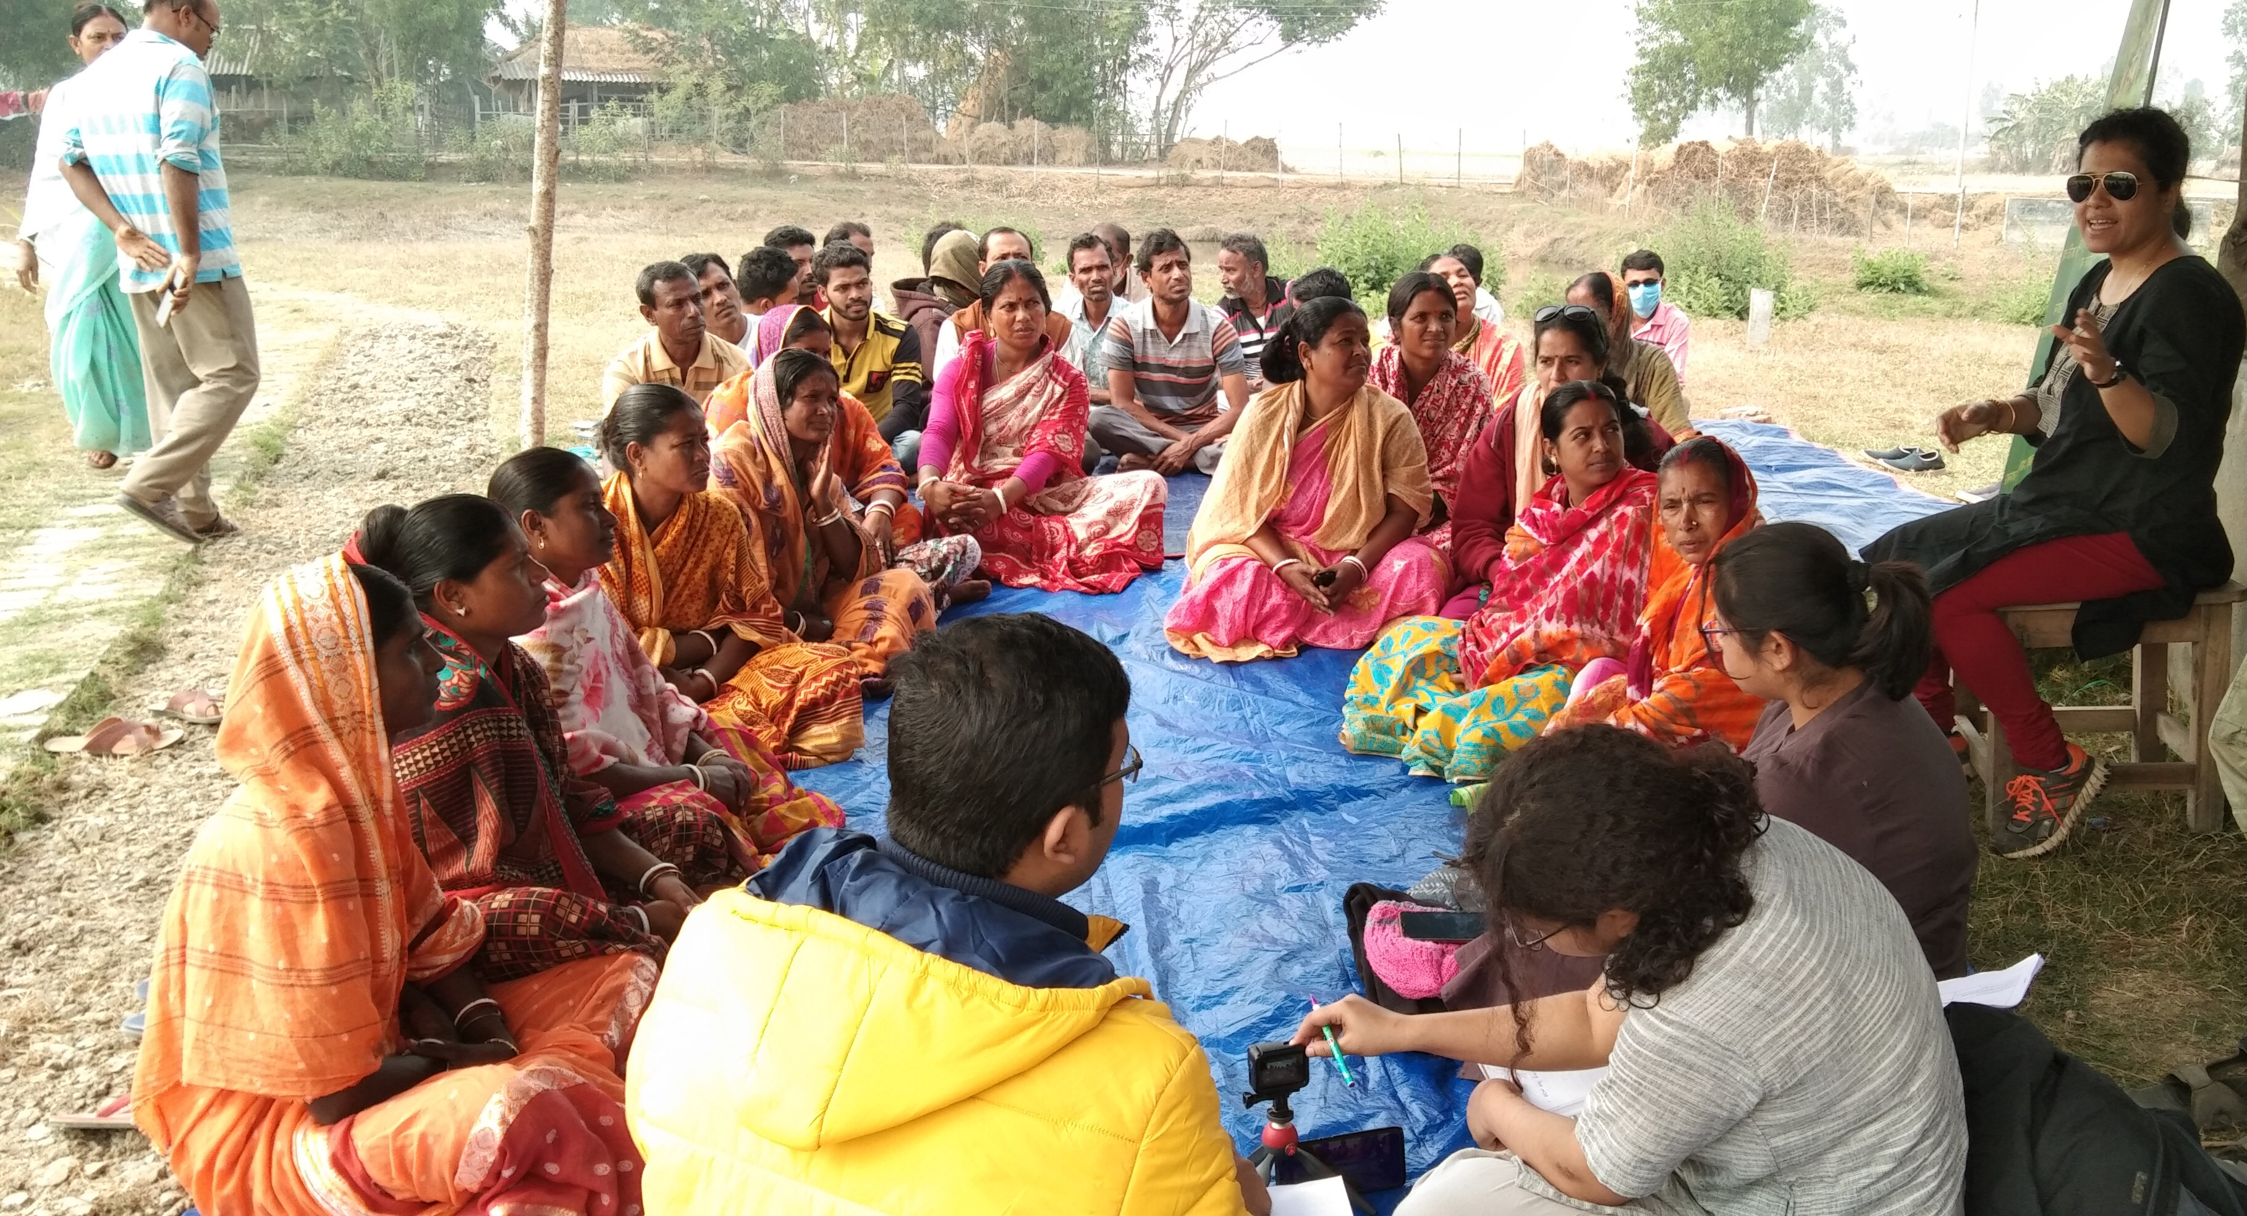
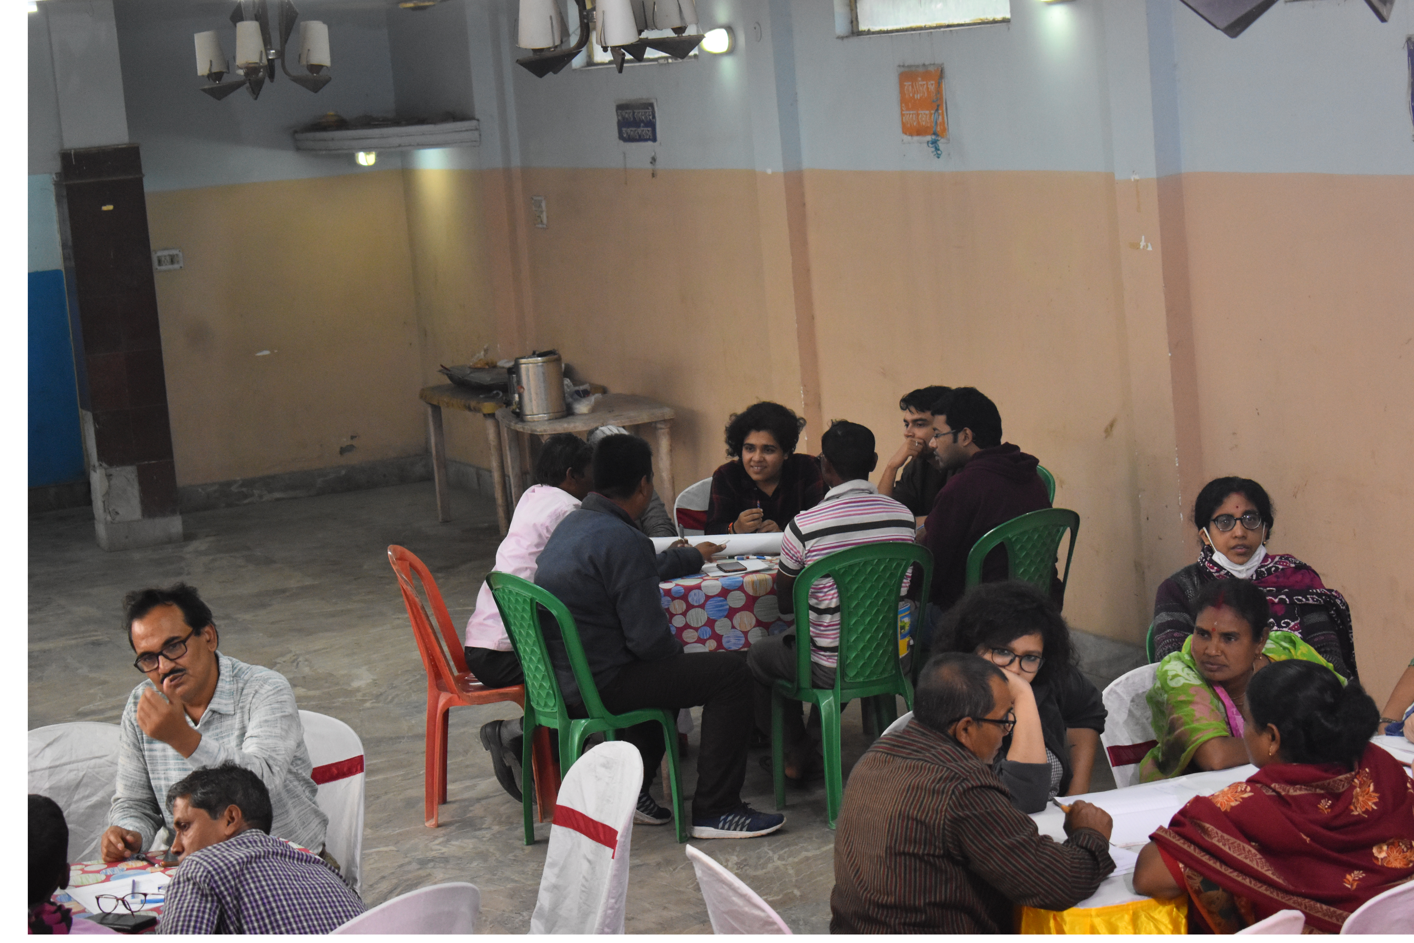
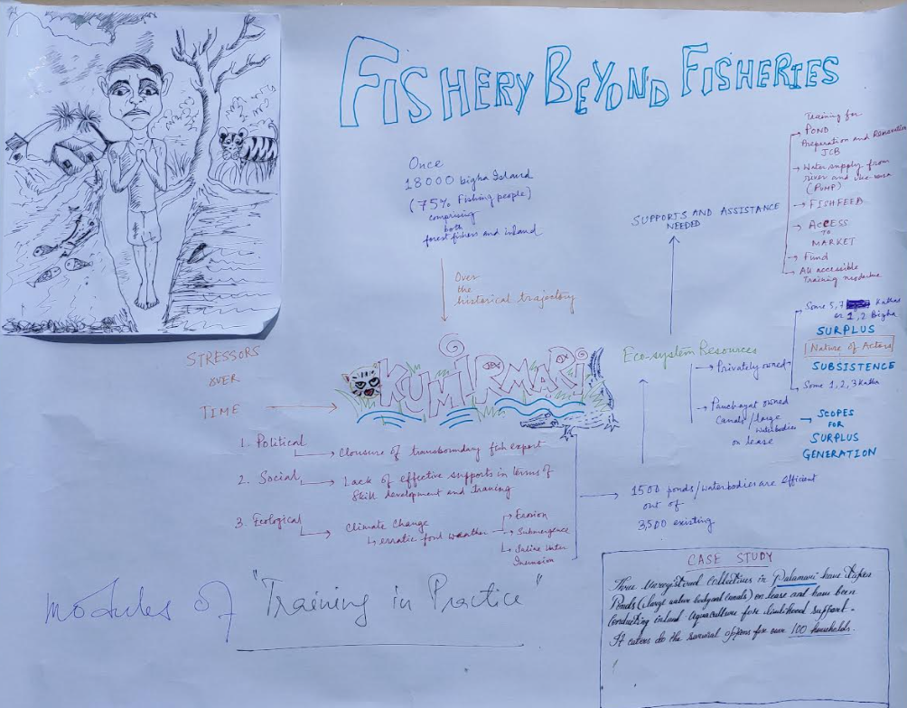
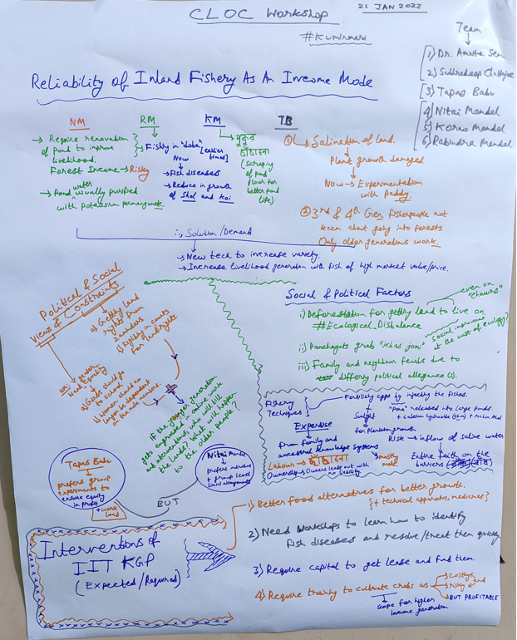
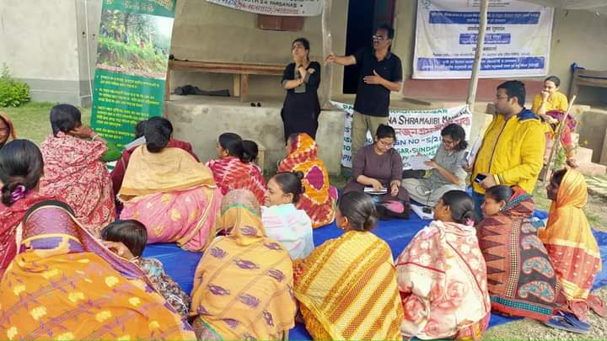
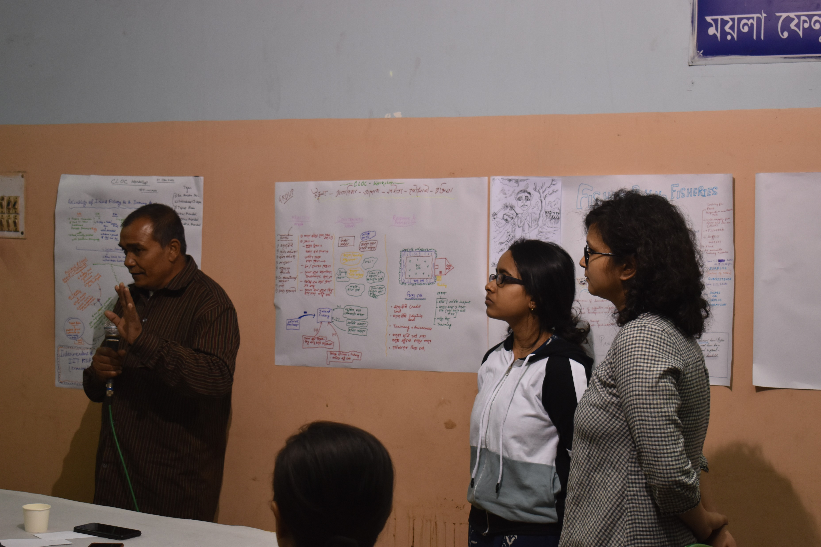
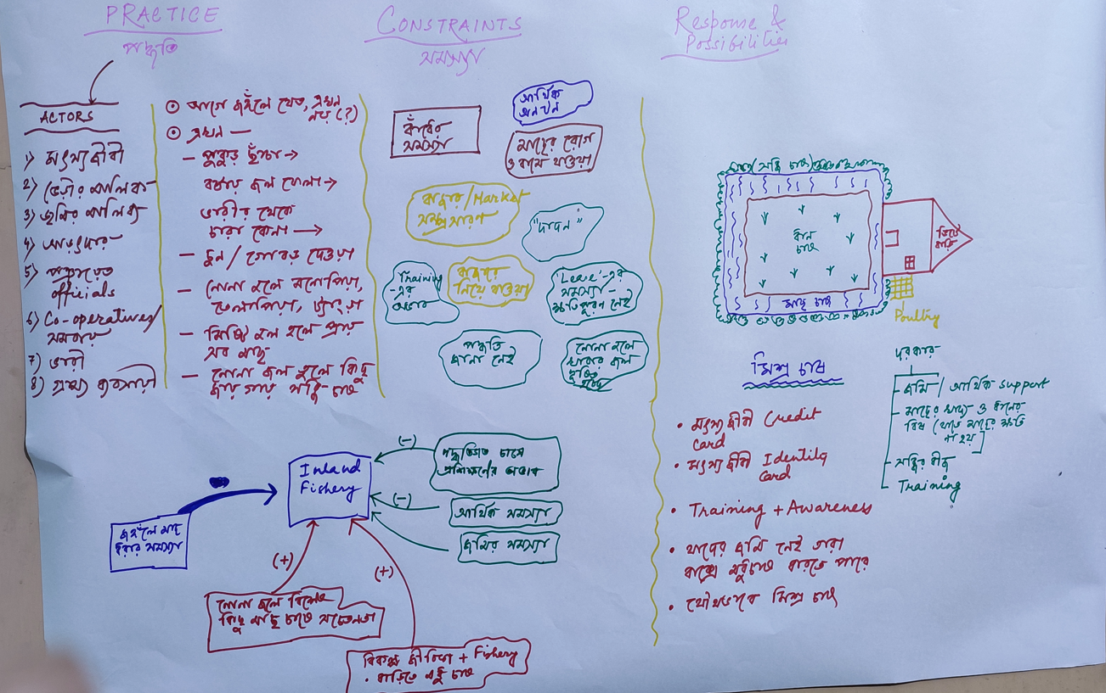
Knowledge coproduction
Source: Adapted from Norström et al. (2020: 184)

Slide 14
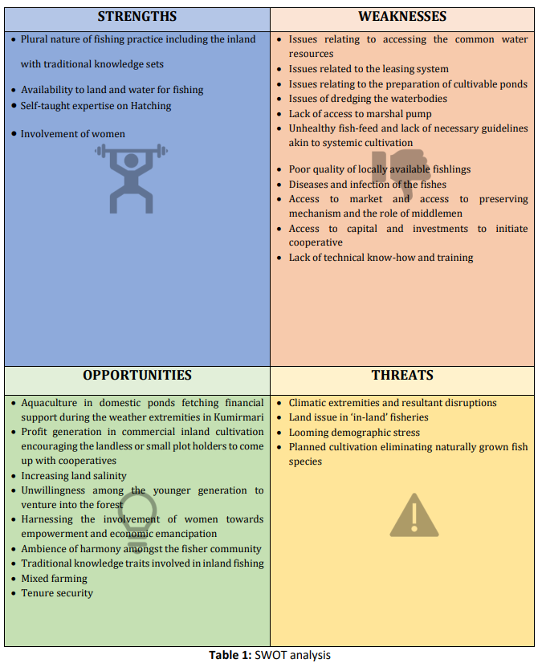
SWOT analysis on inland fishing practices

Slide 15
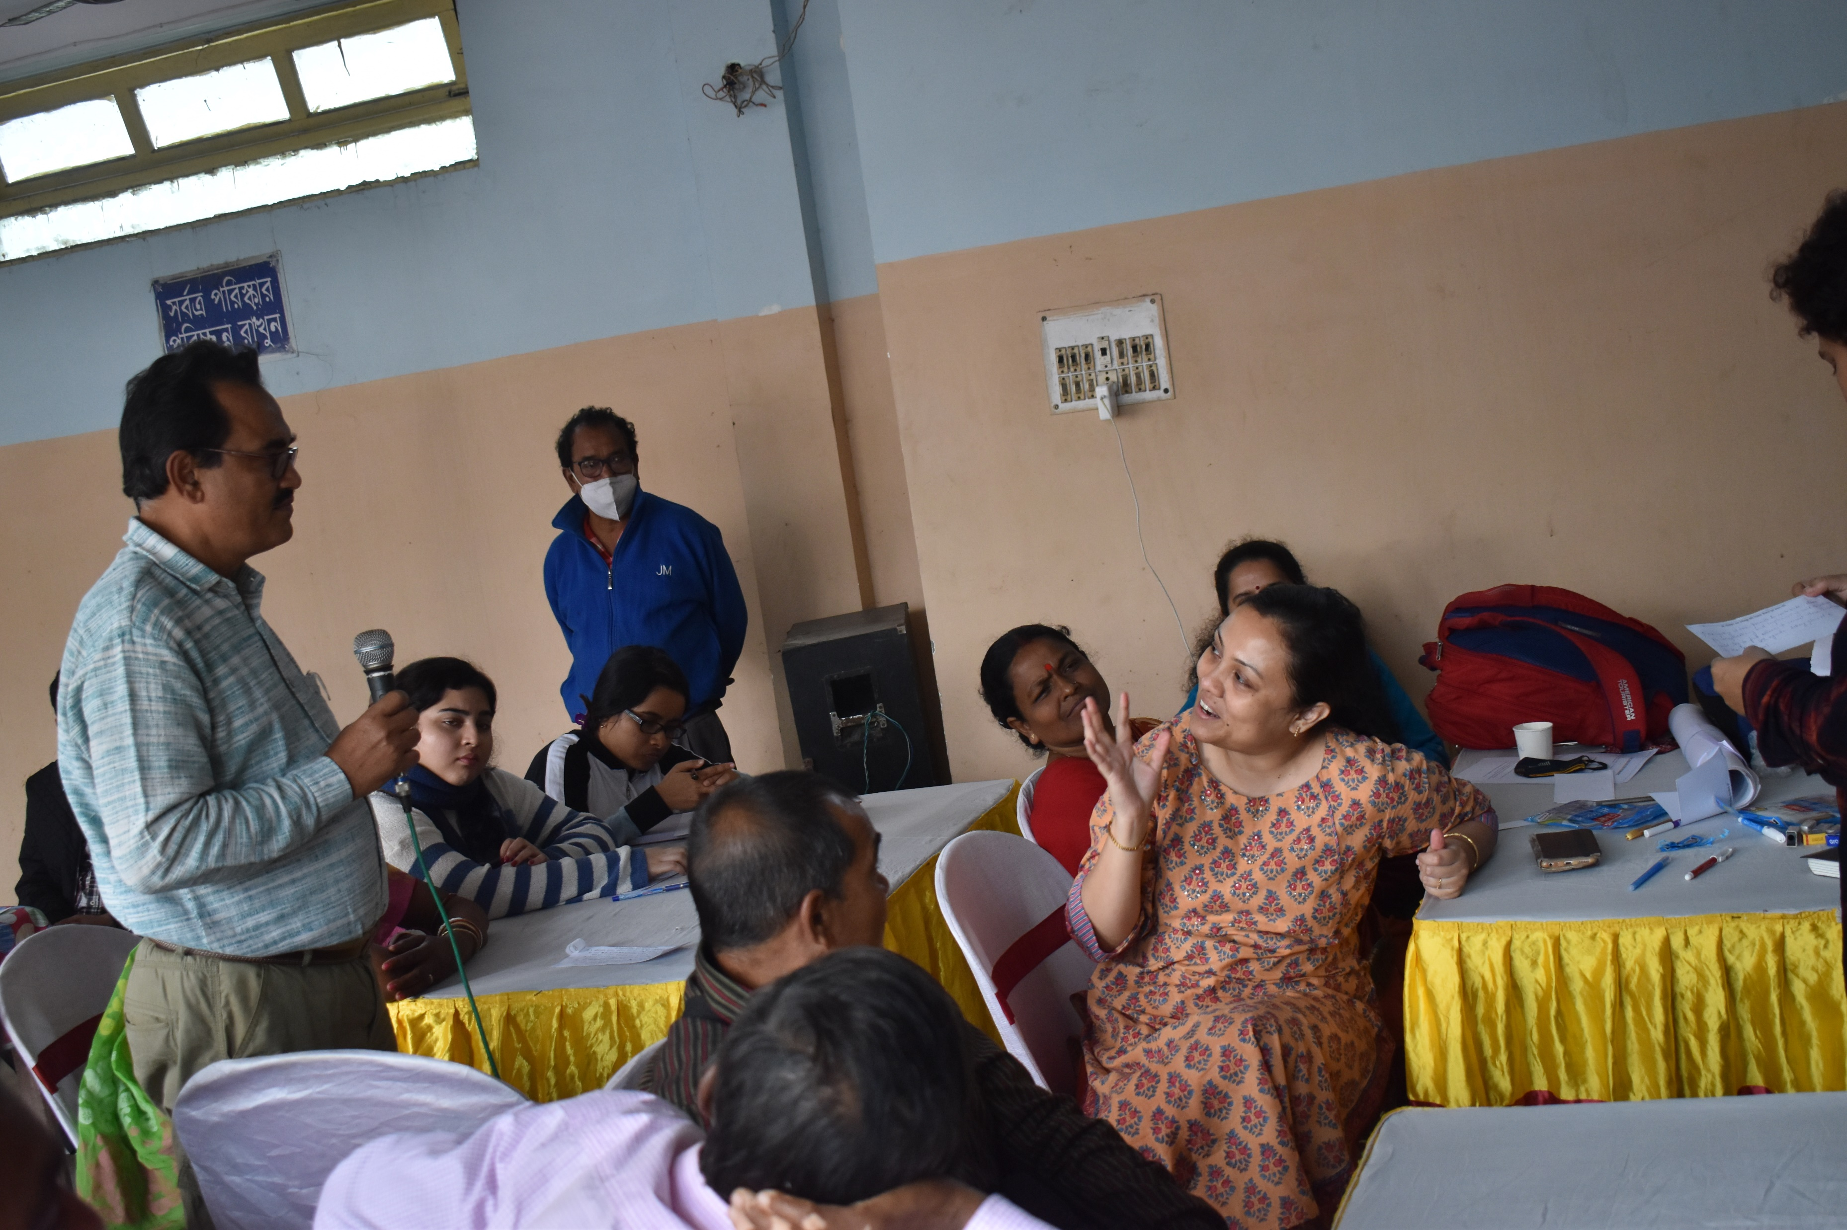
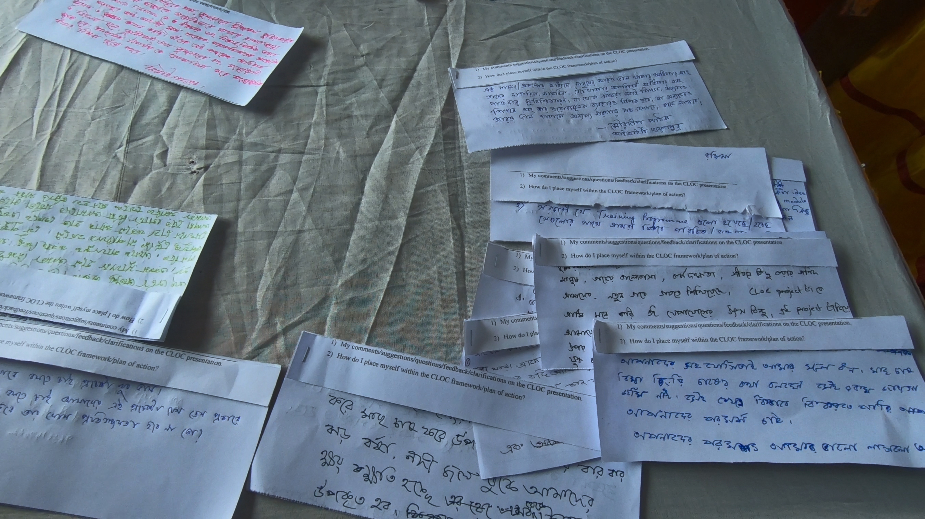
January 2022
Participatory Workshop in Kolkata
direct involvement of scientists and government departments
direct training workshops towards:
increased yield
protection from losses against natural disasters
disease outbreaks among local/cultured species, etc.
documentation of
‘best practices’ should evolve as a bottom-up exercise engaging multiple actors in hands-on fisheries
production, management and marketing
training module generated on the basis of the workshop discussion (preceded with field ethnography) was of no use as the challenges in the ground are multilayered and multi-pronged with time and space acting as dynamic variables shaping each other and influencing arrays of socio-political, ecological and cultural trajectories

Slide 16
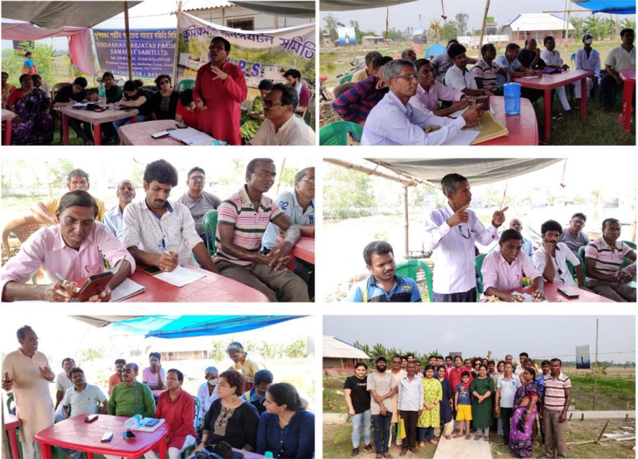
March 2022
On-site multi-stakeholders’ exchange and engagement CLOC K2A workshop

Slide 17
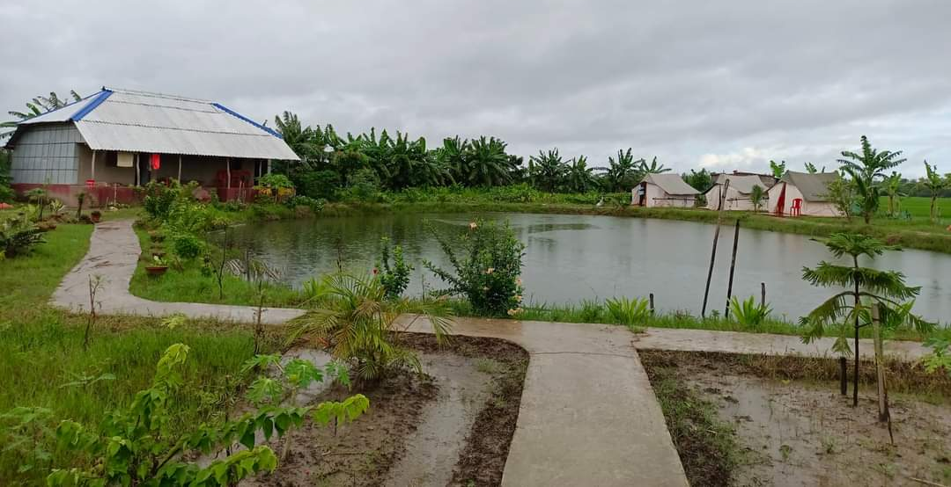
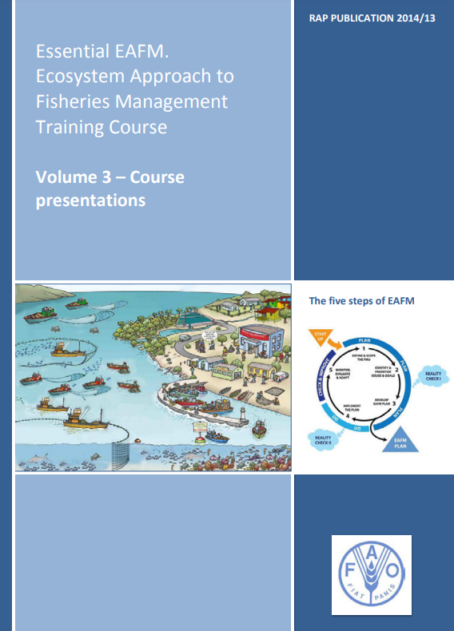
(Pilot) experimentation
Notes:
Access to practical manuals on inland fisheries management (FAO 2019) exposed us to the need to apply Essential-ecosystem Approach to Fisheries Management (EAFm) in designing integrated training modules. EAFm represents a move away from fisheries management that focuses on single target species, towards a systems-based decision-making process that aims to balance environmental, human and social well-being through improved governance frameworks. It is an ecosystem-based, stakeholder-led approach “taking into account environmental, social and economic needs, as well as addressing the governance context” (FAO 2019: 5). Our specializations in political ecology, socioecological systems and social resilience enabled us to map multiple drivers and dynamics to strengthen situated adaptive practices by eliciting fisheries co-management options in Kumirmari. The task appeared to be more robust than initially thought upon awaiting – situational analysis of the 48 village in terms of quantitative data relating to inland fishing (number of waterbodies and their ownership patterns, percentage of households engaged in the venture, fish species cultured, generic challenges encountered against floods, cyclones, etc. and specific problems pertaining to the size of ponds, technological and financial constraints, lack of knowledge, expertise, motivation, etc.). On-site field workshop(s) forging multi-stakeholders’ engagement involving government trainers, fishers, local panchayat, the partner NGO with our group acting as the liaison to design an immediate action plan on fish production in an identified (cooperative/NGO-managed) waterbody appeared to be the tangible output informing the practice-induced training module, to be then developed and disseminated towards sustained and meaningful impact, manifesting community needs, aspirations, involvement and engagement

Slide 18
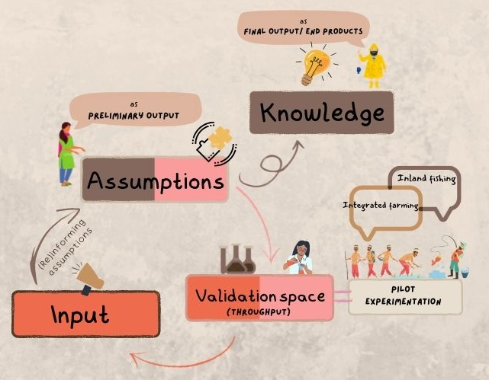
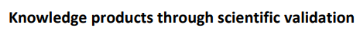
Action 2 Knowledge
“Practice-oriented” training manual

Slide 19

Continuum
CLOC K2A 1
CLOC K2A 2
Ethnography 2 Experimentation
validation space

Slide 20
A
D
D
I
E
Analysis
Design
Development
implementation
Evaluation

Slide 21
A
D
D
feasibility mapping
data streamlining
template (implementation logistics)

Slide 22
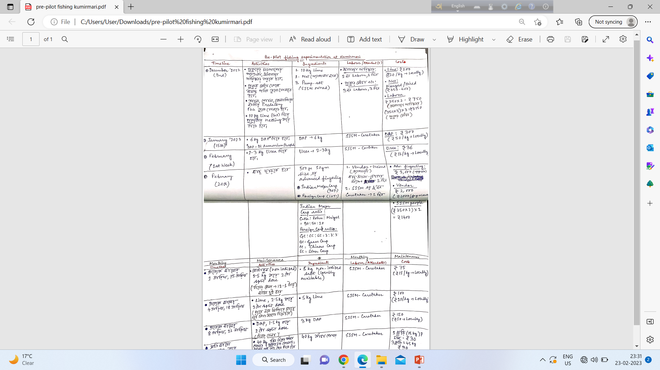
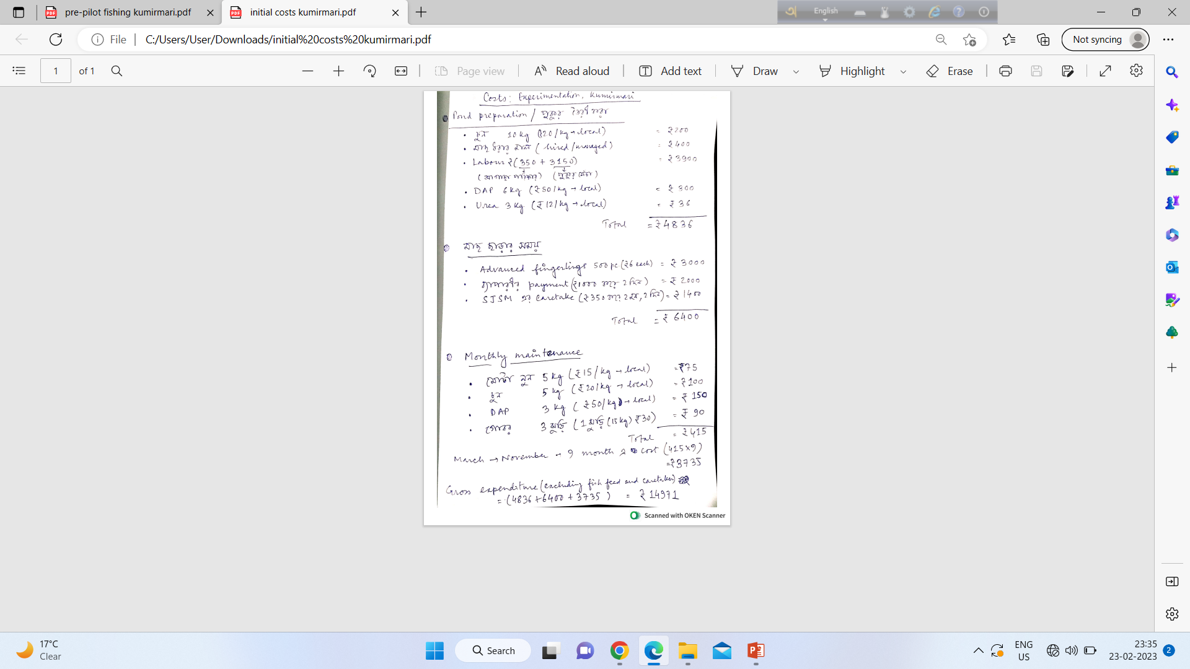

Slide 23
A
D
D
I
feasibility mapping
data streamlining
template (implementation logistics)
validation space (activation)

Slide 24
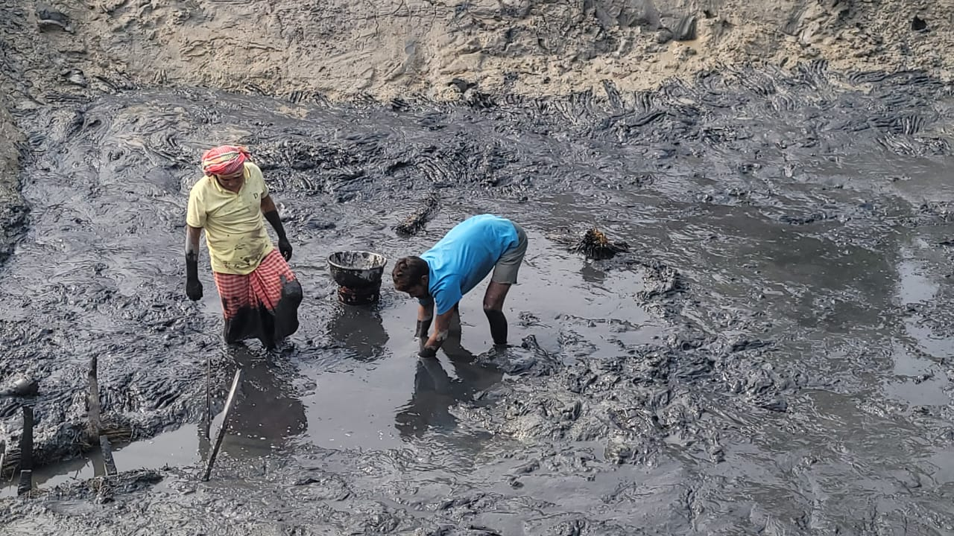
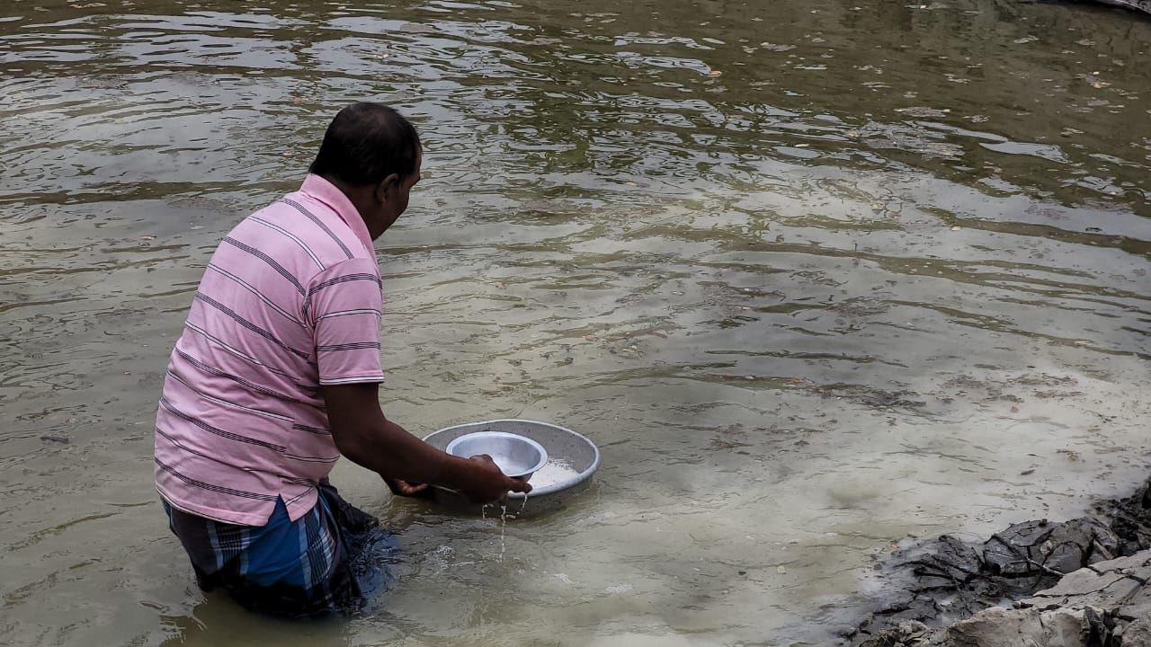
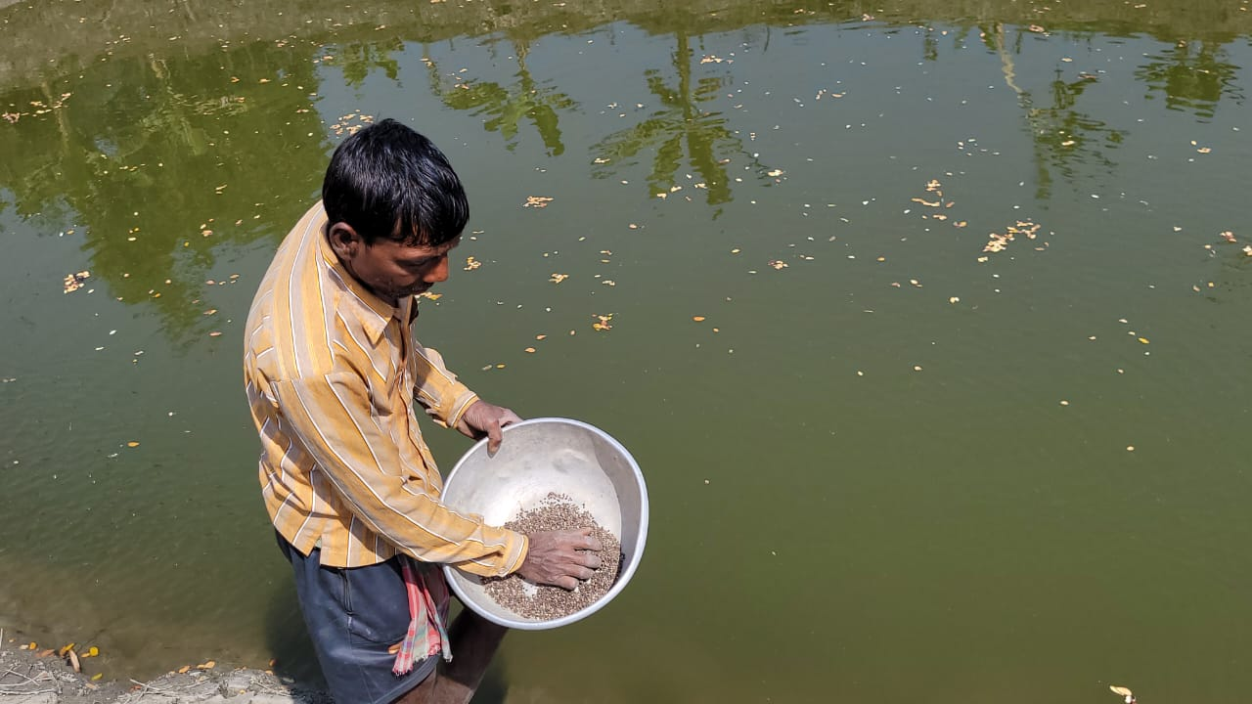

Slide 25

A
D
D
I
co-involved enforcement and monitoring mechanisms
E
feasibility mapping
data streamlining
template (implementation logistics)
validation space (activation)

Slide 26
